Slide 1

COVID-19 Real-Time Android App
PRESENTED BY GROUP-15
Guide : Ms. Smita Dandge

Slide 2

Team Members
1
ADITYA MISHRA
2
MEET MEWADA
3
OM DUBEY
SARVESH KARANGUTKAR
4

Slide 3
INTRODUCTION

Slide 4

COVID-19 Real-Time Android App
The New Coronavirus
COVID-19 Tracker
COVID-19 Tracker visualizes Global COVID 19 data. It provides real-time tally of COVID-19 patients in India (Global data added in v1.1). It covers global level, nation level and state level (only for India) cases. A Mobile application to track the COVID-19 cases made using Kotlin. Complete applicaion with neat UI and full API Integration Thanks to COVID19India.org for open-source API.

Slide 5
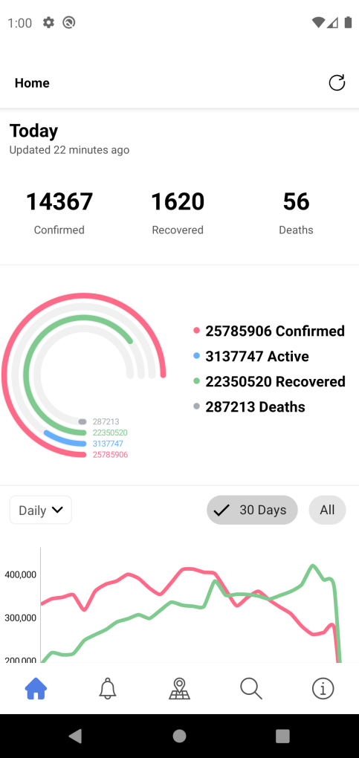
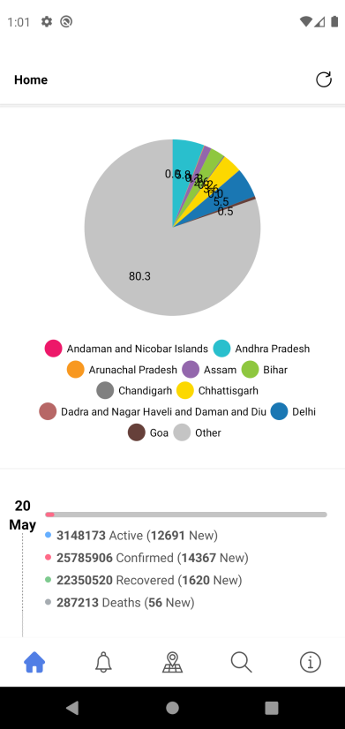
Process and Function
The New Coronavirus
The New Coronavirus
Home Page
The home screen Displays data in real-time fetched from an open source API of https://www.covid19india.org/
This pie diagram displays data from all over India with a percentage-pie diagram. Every state is indicated with a different color for identification purpose.
In this screenshot we can visualize total number of deaths, active, confirmed and recovered cases.
The status bar below the Donut Diagram displays daily data of selected state (which refreshes daily)
We can see the pie chart in the form of graphical representation also.

Slide 6
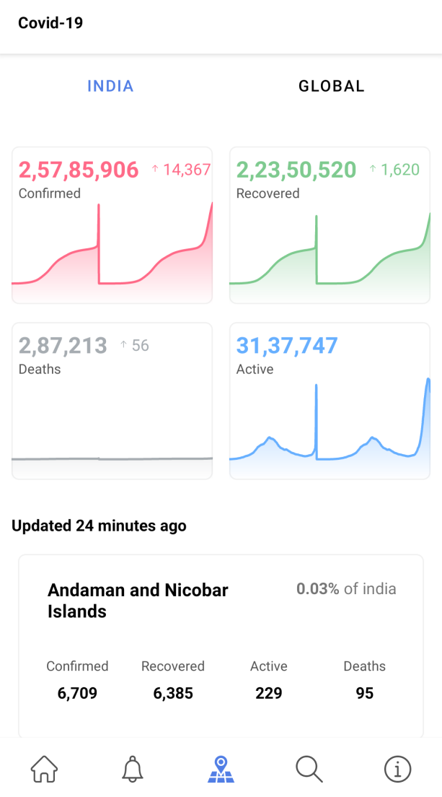
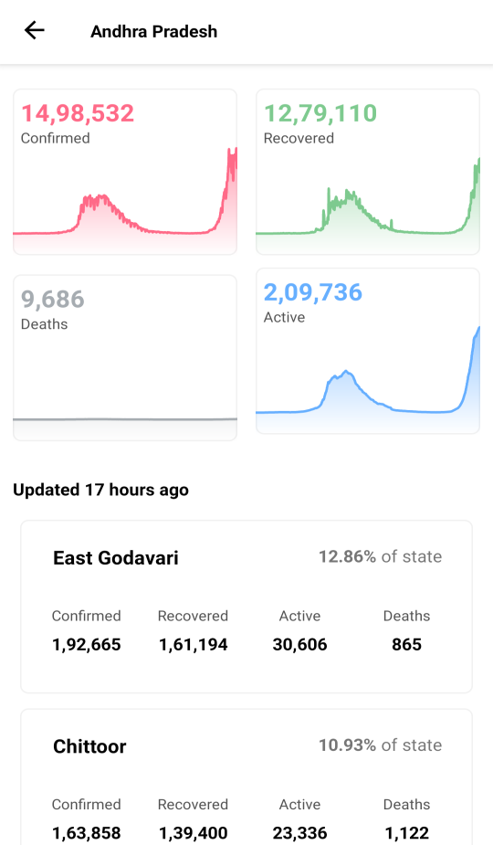
Process and Function
The New Coronavirus
Process and Function
The New Coronavirus
Live Updates
The Covid-19 info page contains data from all over the world and states within it.
Data can be classified into different states and cities.
In this picture we can visualize sub stats of Andhra Pradesh
For example this picture displays data of Andaman and Nicobar Islands.

Slide 7
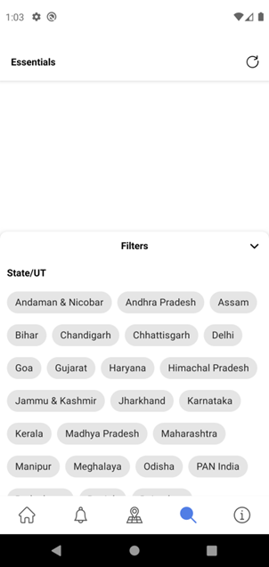
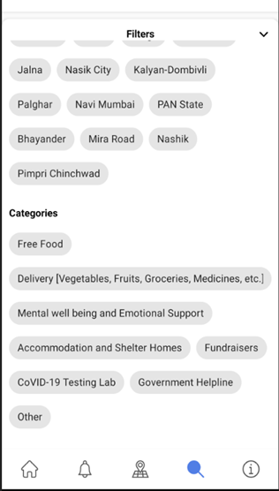
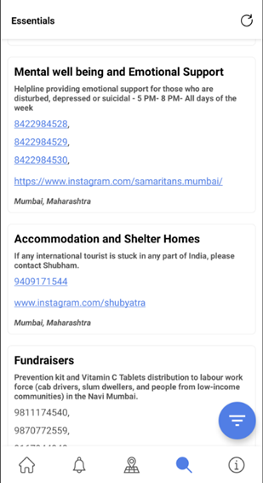
Process and Function
The New Coronavirus
Process and Function
The New Coronavirus
Search Page
The search section in this app contains helpline numbers and data from all states of India.
User can select any state to view the state’s helpline info and aid.
For example the third picture here displays the helpline details and aids from Mumbai, Maharashtra

Slide 8

Technologies Used
1
Kotlin
Koin
2
MVVM Architecture
3
AndroidX
4
Retrofit 2
5
Material Design
6
Moshi JSON Parser
7
Android Architecture Component
8

Slide 9
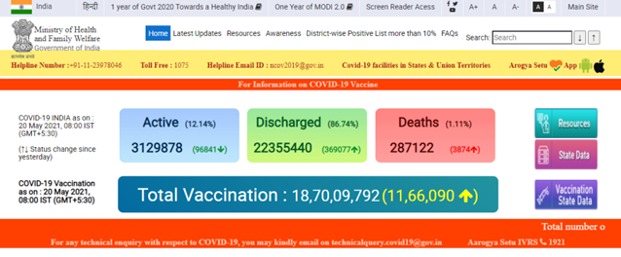
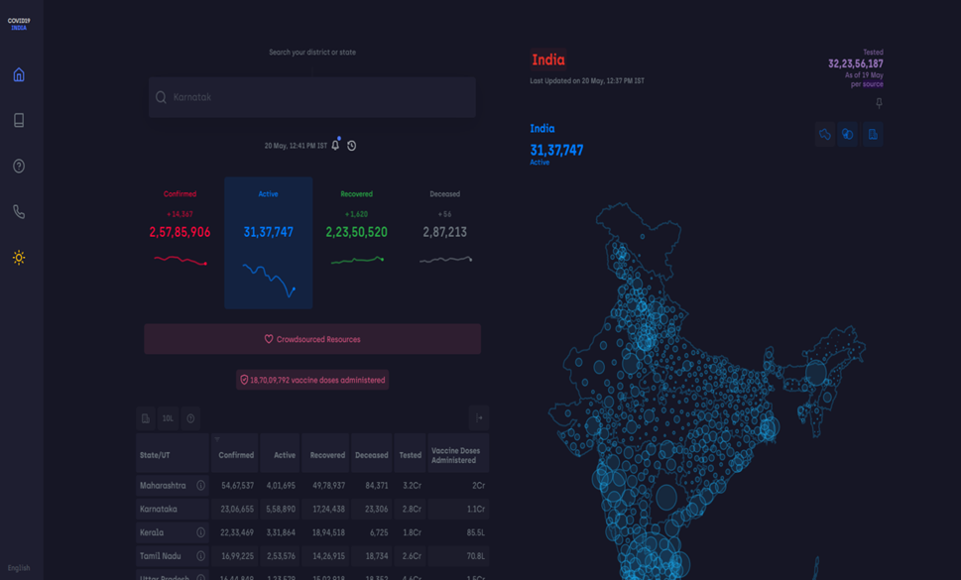
Resources
The New Coronavirus
Thanks to The Ministry of Health & welfare for the data (mohfw)
01
Thanks to [COVID19India.org] (https://github.com/covid19india/api) for open-source API.
02
Thanks to https://www.covid19india.org/ for Real Time Data collection
04

Slide 10
Thank You

